Slide 1


Assessing Reproducibility when the Data is Confidential
Lars Vilhuber, Harry Son, Michael Darisse
Cornell University
The opinions expressed in this talk are solely the authors, and do not represent the views of the U.S. Census Bureau, the American Economic Association, or any of the funding agencies.
© Lars Vilhuber .
Notes:
I am going to
Very briefly describe the background we are coming from
Make note of the various elements of progress (and the broader picture) of open science
Describe some of the ongoing challenges
Provide some guidance based on the lessons learned in the past year

Slide 2

Replication continuum
https://doi.org/10.17226/25303
08
08
08
Reproducibility
Replicability
Generalizability
Narrow Replication (Pesaran 2003)
Pure Replication (Hamermesh 2007)
Verification (Clemens 2015)
Wide Replication (Pesaran 2003)
Statistical Replication (Hamermesh 2007)
Reproduction/Reanalysis (Clemens 2015)
Wider Replication (Pesaran 2003)
Scientific Replication (Hamermesh 2007)
Reanalysis/Robustness (Clemens 2015)

Slide 3
Replication continuum
Same data | Same code | Same methods | Same context
08
Reproducibility
Narrow Replication (Pesaran 2003)
Pure Replication (Hamermesh 2007)
Verification (Clemens 2015)

Slide 4

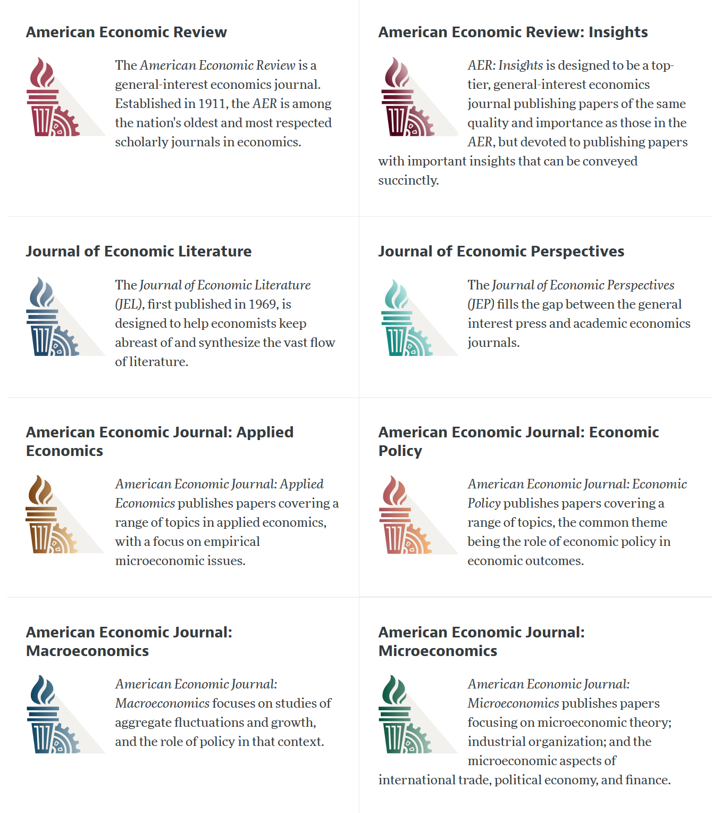

Slide 5
AEA Data & Code Availability Policy (2019)
Access to the data and code must be clearly and precisely documented and is non-exclusive to the authors.
Authors … must provide, prior to acceptance, the data, programs, and other details of the computations sufficient to permit replication, as well as information about access to data and programs.
We test that.

Slide 6
Current efforts at the AEA
Pre-emptively improve code archives
By conducting reproducibility checks when we can
Request data when not freely downloadable
By working with groups or people that conduct reproducibility checks when we cannot
Proprietary and confidential data pose a challenge
How do you check code when the data access is complex?
Notes:
Add logo from AEA

Slide 7
Data citation and provenance analysis
Report on
provenance and data citations
Request for evaluation
Report on
computational reproducibility
Conduct reproducibility check
Can we access all the data?
Do we know how/
somebody who can?
Contact
third party
Conducts reproducibility check
Conduct
Code
check
Report on
potential reproducibility

Slide 8
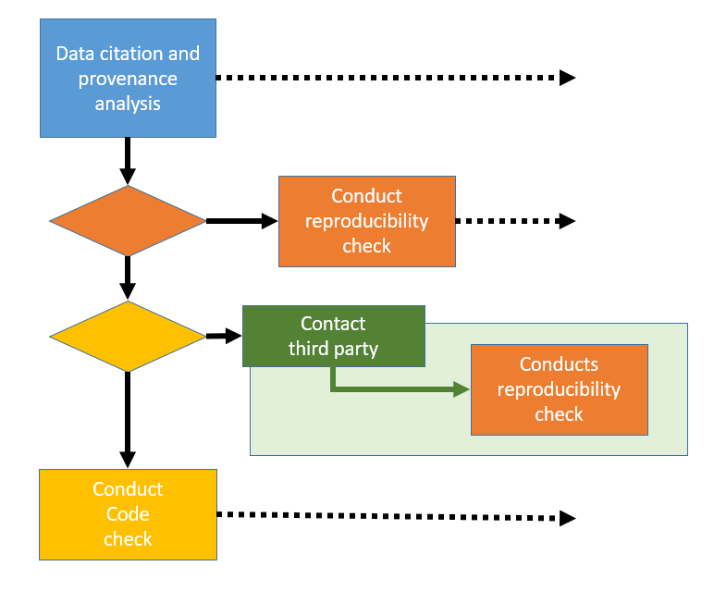
Report on
provenance and data citations
Request for evaluation
Report on
computational reproducibility
Report on
potential reproducibility

Slide 9
Request for evaluation
Report on
provenance and data citations
Report on
computational reproducibility
Report on
potential reproducibility
Summary indicator of reproducibility

Slide 10
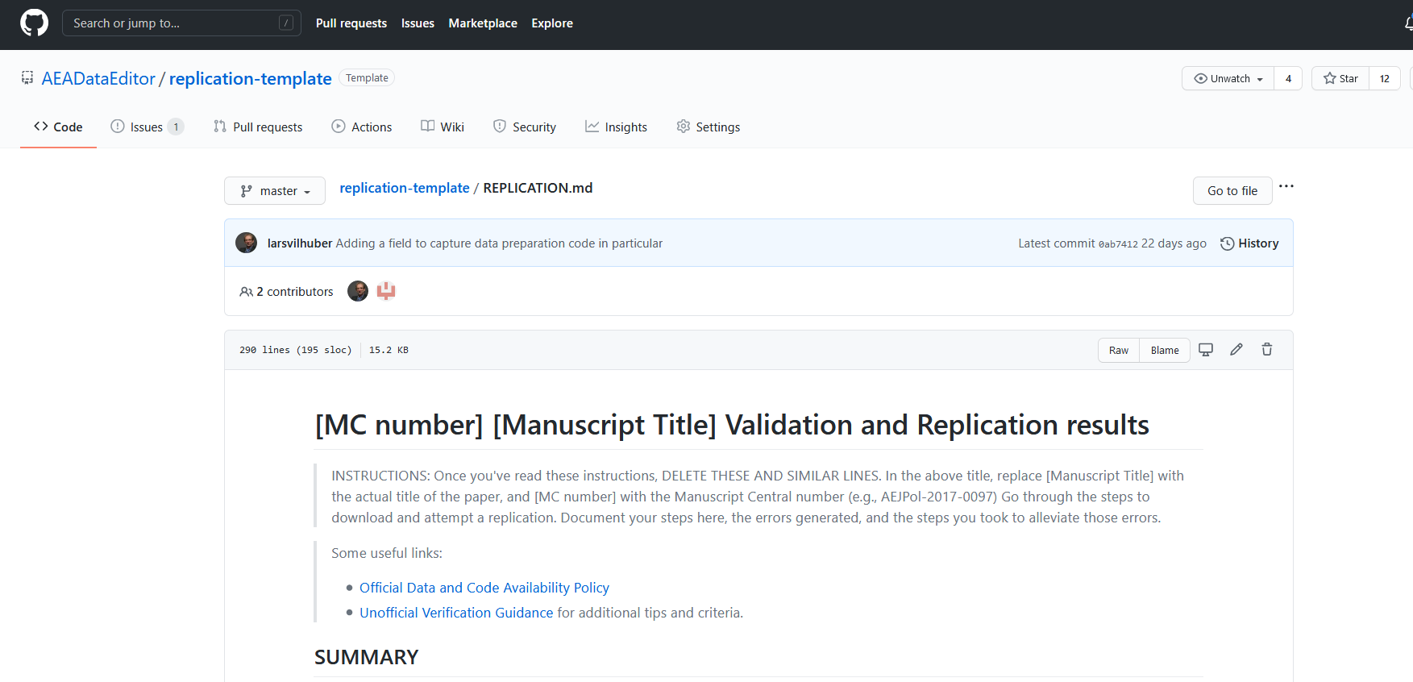
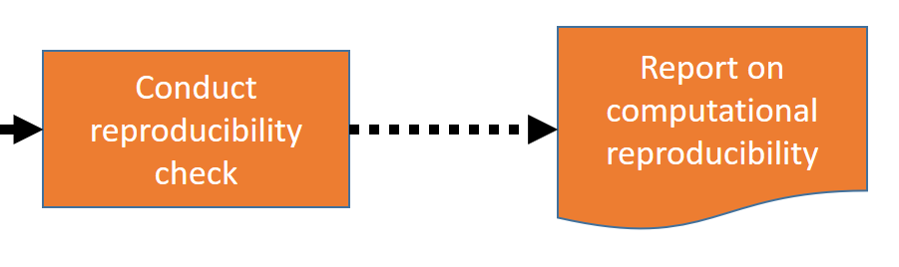
What is the reproducibility check?

Slide 11
What is the reproducibility check?
Data checks
Code description
Requirements
As stated by author
As encountered by replicator
Verbose description of steps to replicate
Findings
Compare tables
Compare figures
Compare in-text numbers

Slide 12
What is the reproducibility check?
Data checks
Code description
Requirements
As stated by author
As encountered by replicator
Verbose description of steps to replicate
Findings
Compare tables
Compare figures
Compare in-text numbers
INSTRUCTIONS: When data are present, run checks:
Can data be read (using software indicated by author)?
Is data in archive-ready formats (CSV, TXT) or in custom formats (DTA, SAS7BDAT, Rdata)?
Does the dataset have variable labels?
Run check for PII. Apply judgement.

Slide 13
What is the reproducibility check?
Data checks
Code description
Requirements
As stated by author
As encountered by replicator
Verbose description of steps to replicate
Findings
Compare tables
Compare figures
Compare in-text numbers
INSTRUCTIONS:
Review the code (but do not run it yet).
Identify programs that create "analysis files" ("data preparation code").
Identify programs that create tables and figures. Not every deposit will have separate programs for this.
Identify all Figure, Table, and any in-text numbers.

Slide 14
What is the reproducibility check?
Data checks
Code description
Requirements
As stated by author
As encountered by replicator
Verbose description of steps to replicate
Findings
Compare tables
Compare figures
Compare in-text numbers
Software Requirements
Version of software (Stata 15, Matlab R2019b, etc.)
Complete list and version of packages!
Computational Requirements
Type, vintage, memory size, speed of computer
Disk space!
Time Requirements
Minutes, hours, days, weeks, months?

Slide 15
What is the reproducibility check?
Data checks
Code description
Requirements
As stated by author
As encountered by replicator
Verbose description of steps to replicate
Findings
Compare tables
Compare figures
Compare in-text numbers
INSTRUCTIONS
Provide details about your process of accessing the code and data.
DO describe actions that you did as per instructions
DO describe any other actions you needed to do ("I had to make changes in multiple programs”)
Findings come later

Slide 16
What is the reproducibility check?
Data checks
Code description
Requirements
As stated by author
As encountered by replicator
Verbose description of steps to replicate
Findings
Compare tables
Compare figures
Compare in-text numbers
INSTRUCTIONS:
Describe your findings both positive and negative in some detail, for each Data Preparation Code, Figure, Table, and any in-text numbers.
When errors happen, be as precise as possible.
For differences in figures, provide screenshot of manuscript figure, as well as the figure produced by the code you ran.
For differences in numbers, provide both the number as reported in the manuscript, as well as the number replicated.

Slide 17
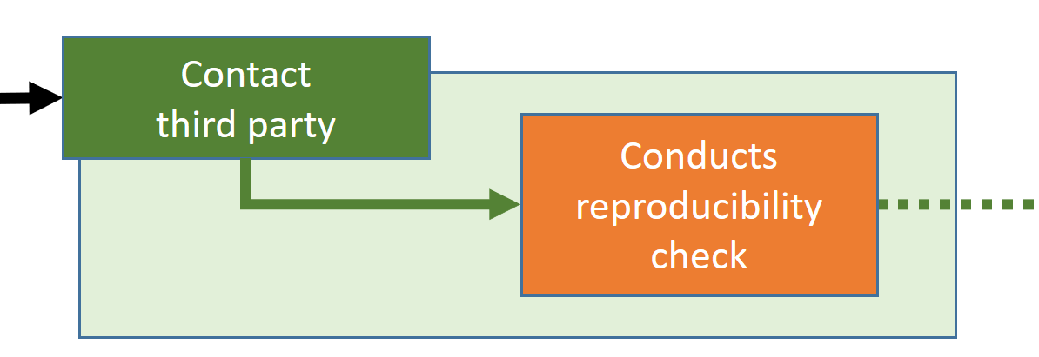
Who do we contact when we cannot access the data ourselves?

Slide 18
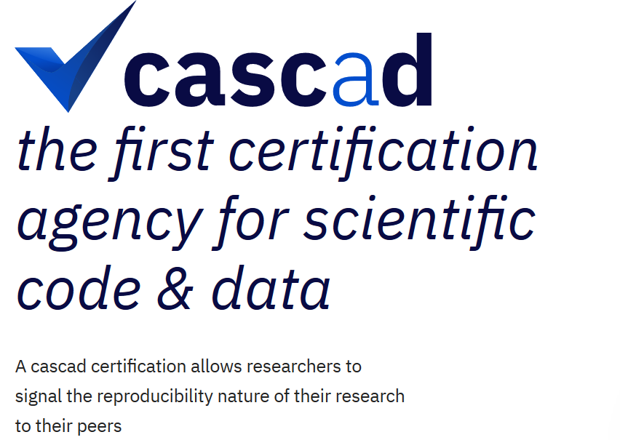
Who are the 3rd parties?
cascad – Using confidential data!
DADS
French customs data
Various contributors with access to confidential data
Authors
Graduate assistants
Their institutions
Network of known groups with access (less frequent)

Slide 19
Who are the 3rd parties?
cascad – Using confidential data!
DADS
French customs data
Various contributors with access to confidential data
Authors
Graduate assistants
Their institutions
Network of known groups with access (less frequent)
Some other examples:
IFAU (Swedish data)
Fed Board (proprietary data)
Upjohn Institute (US admin data)
JCT (US tax data)
Banco do Portual (LEED)
IAB (German data)
Graduate students at Wharton, Chicago, Yale, Wisconsin, Cornell

Slide 20
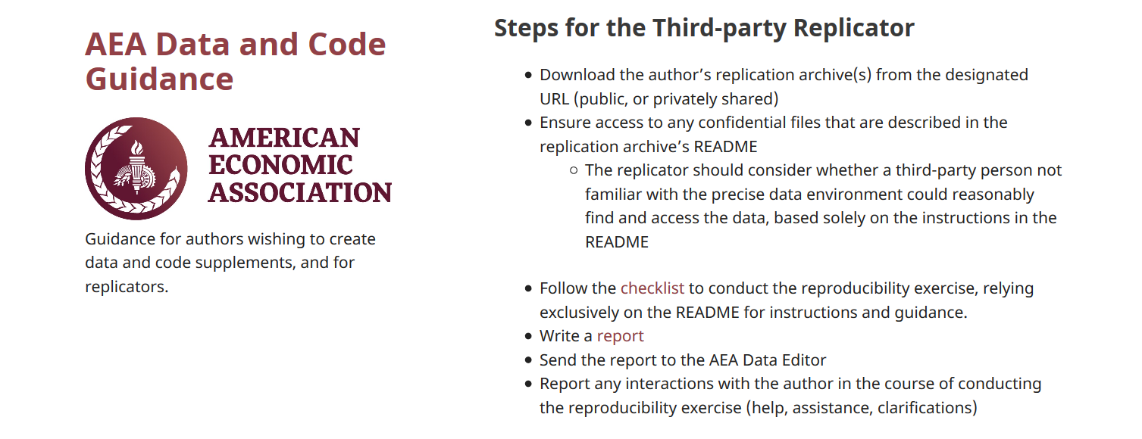
How to prepare the replication package
README
Full package of all programs, data you intend to provide
ZIP it up
Now ask an RA/ colleague/ friend/ grandma/ daughter not previously involved to
Download the package
Follow the instructions in the README without talking to you!
Compare the results to the paper
That’s our Protocol!

Slide 22

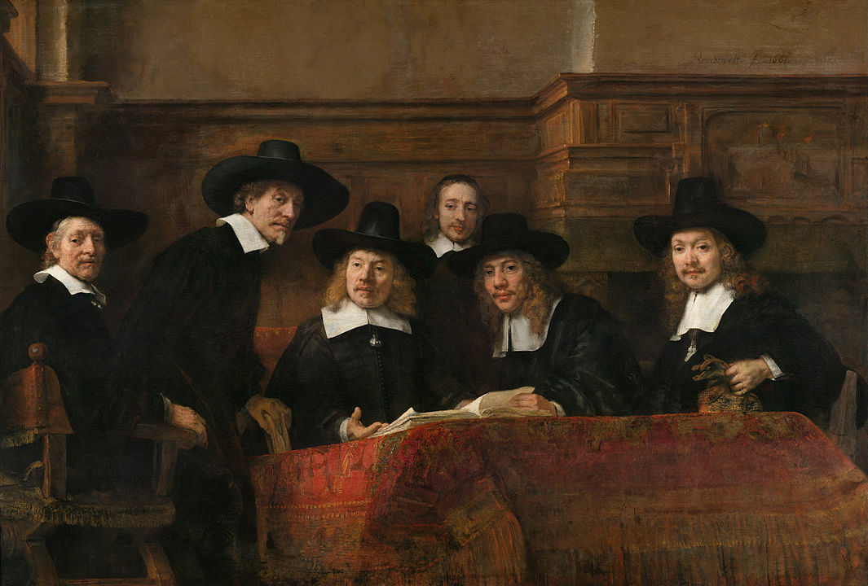
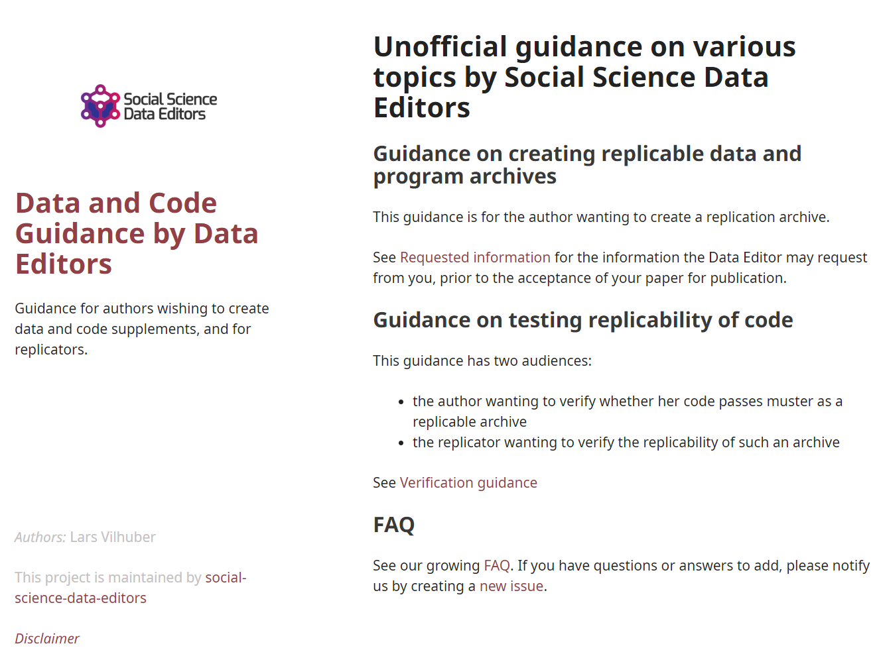
Social science “guild”
https:// social-science -data-editors. github.io/ guidance/

Slide 23

Some resources
https://social-science-data-editors.github.io/guidance/
https://aeadataeditor.github.io/aea-de-guidance/
template README
discussion of licensing
data citation guidance
German example:
Establishment History Panel (BHP) DOI: 10.5164/IAB.BHP7516.de.en.v1
French verification service “cascad” within French RDC CASD
https://www.casd.eu/en/le-centre-dacces-securise-aux-donnees-casd/certification-de-resultats-cascad-casd/

